Slide 1
Mobile Platforms

Slide 3
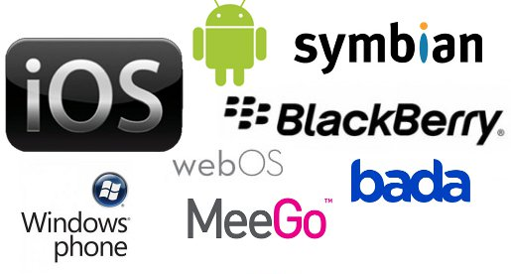

Slide 4
Competitive Landscape
Operating Systems
iPhone
BlackBerry
Windows Mobile
Android
Symbian

Slide 5
iOS
iOS (previously known as iPhone OS) is from Apple Inc.
It has the second largest installed base worldwide on smartphones, but the largest profits, due to aggressive price competition between Android-based manufacturers.
It is closed source and proprietary and built on open source Darwin core OS.
The Apple iPhone, iPod Touch, iPad and second-generation Apple TV all use iOS, which is derived from OS X.

Slide 6
Windows Phone
Windows Phone is from Microsoft.
It is closed source and proprietary.
It has third largest installed base on smartphones behind Android and iOS.
It includes full integration of Microsoft services such as OneDrive and Office, Xbox Music, Xbox Video, Xbox Live games and Bing, but also integrates with many other non-Microsoft services such as Facebook and Google accounts.
Windows Phone devices are made primarily by Nokia, along with HTC, Samsung.
As of 21 January 2015, Microsoft has announced that the Windows Phone brand will be phased out and replaced with Windows 10 Mobile.
Current Windows Phone's version list:
Windows Phone 7
Windows Phone 7.5
Windows Phone 7.8
Windows Phone 8
Windows Phone 8.1

Slide 7
BlackBerry
BlackBerry 10 (based on the QNX OS) is from BlackBerry.
As a smart phone OS, it is closed source and proprietary.
BlackBerry 10 is the next generation platform for BlackBerry smartphones and tablets.
All phones and tablets are manufactured by Blackberry itself.
Once one of the dominant platforms in the world, its global market share has been reduced to 0.4% by the end of 2014.
Current BlackBerry 10's version list:
BlackBerry 10.0
BlackBerry 10.1
BlackBerry 10.2
BlackBerry 10.3

Slide 8
Firefox OS
Firefox OS is from Mozilla. It is open source and uses Mozilla Public License
Sailfish OS
It is partly open source and adopts GPL (core and middleware), however the user interface is closed source.
After Nokia failed in 2011 with the MeeGo project most of the MeeGo team have left Nokia, and established Jolla as a company to use MeeGo and MER business opportunities.
In 2012 Linux Sailfish OS based on MeeGo and using MER core distribution has been launched for public use.
The first device, Jolla (mobile phone) was unveiled on 20 May 2013.

Slide 9
Tizen
Tizen is hosted by the Linux Foundation and support from the Tizen Association, guided by a Technical Steering Group composed of Intel and Samsung.
Tizen is an operating system for devices including smartphones, tablets, in-vehicle infotainment (IVI) devices, and smart TVs.
It is an open source system(However the SDK was closed source and proprietary) that aims to offer a consistent user experience across devices.
Tizen will be targeted at a variety of platforms such as handsets, touch pc, smart TVs and in-vehicle entertainment.
Ubuntu Touch OS
Ubuntu Touch OS is from Canonical Ltd.. It is open source and uses the GPL license.

Slide 10
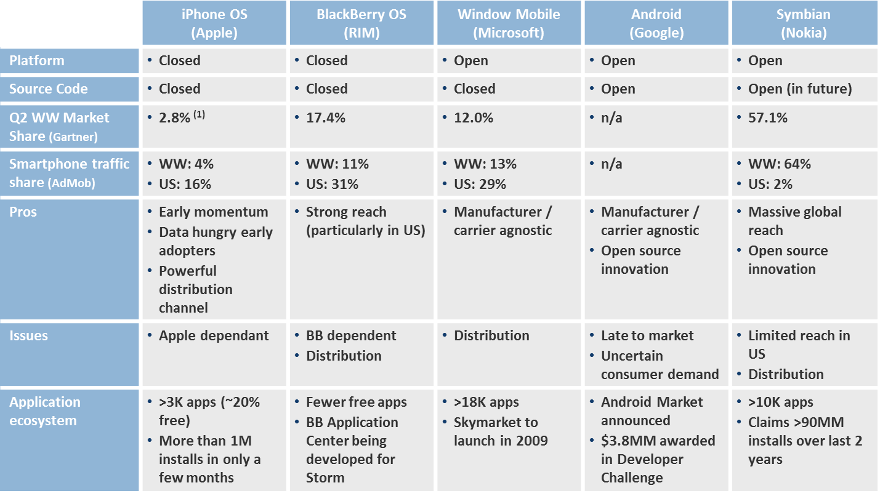

Slide 11
Discontinued Platforms
Symbian
Palm OS
Web OS
Maemo
MeeGo
Limo

Slide 12
App Development approaches
Driven 3 key aspects
Bussiness usecase (B2C,B2E,B2B).
profile of the user.
The device that play the App(smart device,connectivity,operating environment).
Requirements based on:- user experience,device diversity,offline capabilities,security,backend integration,app lifecycle management.

Slide 13
Approaches
Native(using native API).
Web (to cater diverse device using a single code),but no native look & feel ,nor leverage high end device capabilities.
Hybrid(built using cross platform).
The same codebase of a mobile app can be translated to fit into any of the supported native platforms.

Slide 14
Philosophies to build apps using hybrid approach
1)Web base philosophy:-
2 steps to be followed
step 1 – create web app using the usual web approach.
step 2- Wrap the web app with a native wrapper.
To enable the app to leverage the underlying hardware features in a device.
Framework such as jQuery Mobile or Sencha Touch –create web app
Tools like Adobe phone gap are used to provide native wrapper.

Slide 15
2)Cross-compiler philosophy-
created using web technologies & resultant app cross compiled
for the supported mobile native platforms.
Tools such as Appcelerator Titanium are used to create these app.

Slide 16
Middleware philosophy
App is hosted on a middleware server.
User retrieve the app from middleware as & when required.
Middleware server facilitate interaction between the app &enterprise system at backend.
Full-fledged commercial Mobile Development Platform(MADPs)
SMP or Kony are primarily used as middleware.

